Slide 1
Lucky Cement Limited
FY 2020 Analyst Briefing
August 28, 2020

Slide 2
Table of Contents
Key Highlights
Consolidated - Business Revenue
Consolidated - Operating Profits
Sales & Market Share
2020 V 2019
Foreign Operations
Consolidated - Profit & Loss
Outlook

Slide 3
Key Highlights
COD of new Line in Pezu – 2.8 MTPA – Jan 1, 2020
Significant capacity additions in the North in last 2 years resulted in major demand supply imbalance
Covid shook economies – cement industry was growing at 7%, in 9M20 then ended at 2% for FY 20
GIDC upheld as intra-vires, review petition planned
Resolution of Inter-Corporate div tax issue
LEPCL target COD June 2021 – PKR 19.45Bn invested – Balance equity ~ $50M
Key Figures FY 2020
Consolidated
Standalone
162.9
Revenue (PKR Bn)
62.3
Revenue (PKR Bn)
15.1
EBITDA (PKR Bn)
5.0
EBITDA (PKR Bn)
7.3
PAT (PKR Bn)
3.3
PAT (PKR Bn)
18.96
Earning Per Share (Rs)
10.34
Earning Per Share (Rs)
3

Slide 4
Consolidated Business Revenue grew by 19%
Segment Wise Revenue (PKR Mn)
Business | FY19-20 | FY18-19 | Growth
Cement | 62,279 | 67,331 | 8%
Chemicals | 66,354 | 67,990 | 2%
Automobiles | 33,826 | 1,271 | 2517%
Others | 978 | - | -
Consolidated | 162,868 | 136,592 | 19%
19%
First year of KIA – a success - supported growth in revenue
Cement Local volumes dropped by 7% but offset by export growth of 19%
Polyester & Soda Ash were affected in last Quarter due to Covid, which was partially offset by increase in Nutrico Morinaga
4

Slide 5
Consolidated Operating Profits reduced by 47%
Segment Wise Operating Profits (PKR Mn)
Business | FY19-20 | FY18-19 | Growth
Cement | 1,185 | 9,987 | 88%
Chemicals | 5,748 | 5,012 | 15%
Automobiles | 497 | (150) | 431%
Others | (347) | (190) | 83%
Consolidated | 7,083 | 14,659 | 52%
47%
Cement operating profit massively went down (reasons in next section)
5

Slide 6
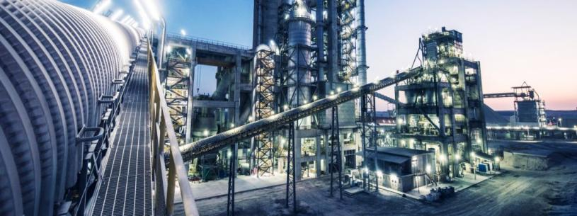
CEMENT

Slide 7
Sales & Market Share
NORTH
SOUTH
7

Slide 8
2020 V 2019
Coal Consumption Variance: Low consumption due to low Clinker production, coupled with lower consumption on Line 1.
Coal Rate: Benefit from decline in Intl' Coal prices [FY20 $73 vs FY 19 $95]
Gas/Furnace: Gas increase by PKR 241 [FY20 Rs. 1221 vs FY19 Rs. 980] from Jul-19; HFO prices declined during the
period [51K vs 69K]
Fixed Cost: Increase in Depreciation by PKR 572 M [Line 1 from Jan-20]
Inventory: Consumption of Clinker op stock 854,025 MT and cl stock 500,716 MT.
Operating Expense: Hike in, local warehouse transportation, Export(Ocean freight & port) along with the Axle load impact.
Interest Income: Lower cash balance due to equity investment in LEPCL.
Dividend Income: ICI ↑0.3M and Royalty ↑0.3M.
Other Charges: Donations↓ PKR 139 M & decline in WWF & WPPF.
Taxation: Benefit due to Minimum tax regime & revocation of Super Tax.
8

Slide 9
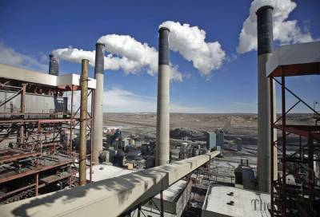
FOREIGN OPERATIONS

Slide 10
Rising Overseas returns!
Joint Venture | A 50:50 JV with Al Shumookh Construction Materials Trading, a local partner | A 50:50 JV with Rawsons Investments Limited, a local partner | A 50:50 JV with Al Shumookh Construction Materials Trading, a local partner
Project Company | Al Mabrooka Cement Manufacturing Company, Basra (Iraq) | Nyumba Ya Akiba, SA, Democratic Republic of Congo | Najmat al Samawah, Iraq
Category | Cement Grinding Unit | Fully integrated cement manufacturing facility | Fully integrated cement manufacturing facility
Capacity in MTPA | 1.742 | 1.188 | 1.2
Status | Started commercial operations in 2014, capacity doubled in 2018. | Started Commercial operations in 2017. | Project completion targeted for 2nd quarter of current FY.
 | FY 2020 | FY 2019 | % | FY 2020 | FY 2019 | %
Sales Volume | 1.11 MT | 0.97MT | 14% | 0.57 MT | 0.57 MT | -
EBITDA (USD 000) | 22,740 | 15,821 | 44% | 36,218 | 19,495 | 86%
10

Slide 11
Consolidated Profit & Loss
Particular | FY 2020 (PKR Mn) | FY 2019 (PKR Mn) | Change (%) | Reasoning
GROSS PROFIT | 18,957 | 23,789 | 20% | GP reduced by 4.8Bn, largely contributed by Lucky’s receding margins
DISTRIBUTION COST | 7,649 | 5,855 | 31% | Increase by 1.8Bn, mainly due to hike in export volume by Lucky, impact of Axle load charges. Along with increasing advertisement and Promotion cost by KIA
ADMIN COST | 4,222 | 3,275 | 29% | A jump of 947Mn with increasing operational activities by KIA this year
FINANCE COST | 2,367 | 1,610 | 47% | An increase of 757Mn witnessed due to an increase in KIBOR & utilization of short term financing facilities
OTHER EXPENSE | 1,203 | 1,904 | 37% | A decline in other expenses of 700Mn on account of reduced Donations, WWF and WPPF payments by Lucky
OTHER INCOME | 2,376 | 2,999 | 21% | Reduction of 1.2Bn due to cash used for Investment in LECPL by Lucky
TAXATION | 1,614 | 2,811 | 43% | Reduced in line with decrease in profitability for Lucky

Slide 12
Outlook
With the current macro-economic situation, in the short to medium term, the Outlook of the Cement industry will continue to improve due to increase in demand in both domestic and international markets.
Local demand has started growing, both in the North and South regions. Based on the demand projections in the North, we expect that the prices will stabilize compared to the outgoing year.
Export sales are anticipated to remain strong, however, prices will remain competitive due to surplus capacities available in the region.
We expect that the package announced for the construction industry by the Federal Government will have a positive impact on the cement demand of the country.
Cement industry’s outlook remains promising on account of the Government’s key initiatives to build both small and mega-capacity / multipurpose water reservoirs / dams, construction of Special Economic Zones as part of CPEC projects, and low-cost affordable houses for the public at large.
12

Slide 13
Thank you

